Slide 1
Session 1: An Introduction to the DPTR

Slide 2
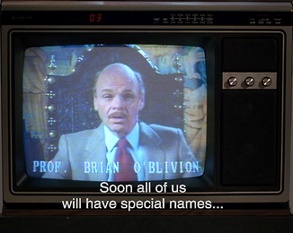
An apology.
“After all, there is nothing real outside our perception of reality, is there? You can see that can't you?”
Dr. Brian O’Blivion
http://tinyurl.com/n8efdmr

Slide 3
Overview:
The DPTR team members
A note on terminology and language
Project motivation
Project background
DPTR requirements
for policy development
for repository processes
for preservation planning and action
The DPTR data model

Slide 4
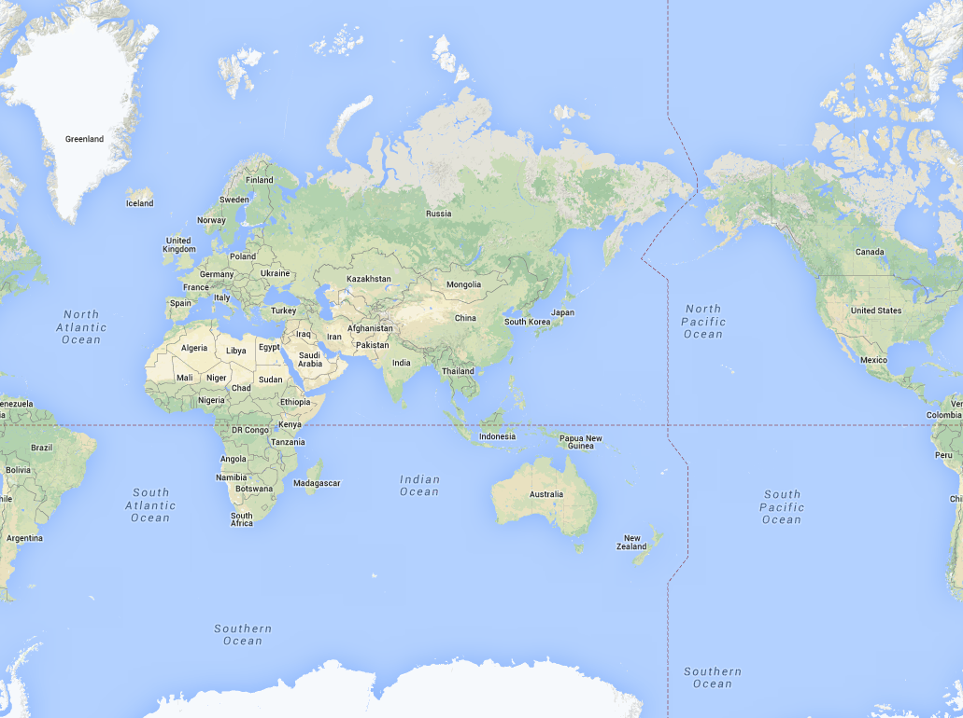
DPTR Team Members
Univ. of Portsmouth
National Archives
and Records Administration
National Library
of Australia
Archives New Zealand
NLNZ

Slide 5
Terminology and language:
It’s tricky.
At NARA we talk about holdings, permanent electronic records, master files, input, output, and copies.
Libraries talk about collections, digital objects, and items.
*“PREMIS chose the term “representation” to avoid the term “manifestation” as it is used in the Functional Requirements for Bibliographic Records (FRBR).”
Terms describing this domain are value laden.
It is difficult to come up with completely ‘new’ terms.
The team has attempted to avoid confusion but…
*http://www.loc.gov/standards/premis/v2/premis-2-0.pdf

Slide 6
Project Motivation
Develop a technical registry that will:
support policy development, risk management, planning and action as central to an ongoing active digital preservation programme
be at the centre of a mature digital preservation market supporting a range of digital preservation products, services and programmes
be deployable in any preservation environment (e.g. Rosetta, SDB, FEDORA, DuraSpace)
provide the knowledge-base from which other products and services will draw to support individual organisation’s digital preservation programmes (e.g. DROID, JHOVE, NLNZ MET)
leverage the experience of the preservation community

Slide 7
Background
Team member experiences in:
Policy development
Processing
Planning
Preservation actions.

Slide 8
Background
Policy Development
Acceptable formats
Processing
Format identification
Preservation
Format conversion
Planning
Preservation plans
Transfer standards
Error checking)
Validation
Migration paths
Emulation
Risk assessment

Slide 9
Current tools:
Are dependent on the PRONOM development roadmap to the detriment of the wider digital preservation community needs
Do not reflect other relevant sources that are available
Lack depth and breadth of information for formats and software
Lack complex linking between information
Insufficient information on hardware and peripherals
Do not allow for the development of community knowledge and best-practice.

Slide 10
Sources for format information:
ISO/ANSI and other specifications
Corporate sites
LC Format Sustainability of Digital Formats
TNA-UK PRONOM Format Registry
CDL/LC UDFR
Wikipedia

Slide 11
Current knowledge bases:
PRONOM
UDFR
LC
Wikipedia
Others
(institutional)

Slide 12
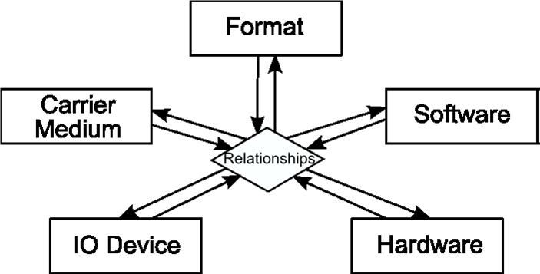
DPTR Data Model

Slide 13
Proposed Format Solution
describe the format world as defined in specifications;
describe the world of formats as found amongst digital objects “in the wild”;
allow for varying levels of understanding a format;
offer information for identifying these descriptions;
be linked to collected associated sources;
be linked to software, hardware and carrier media.

Slide 14
What has been done
July 2012 NSLA funding approved > Wellington workshop
data model WG – weekly meetings
use cases, logical data model, data dictionary, vision document, actor description, conceptual solution documents etc
logical DPTR data model and format data model
testing the format data model (TIFF, pkzip, FLAC, XML...)
market scan, business case documentation
international reviews
articles, presentations, EU bid under the Horizon2020

